Slide 1
Yassir eta prediction app

Slide 2
Agenda
Introduction
Issues encountered
Business Analysis
Models and features
RSME
WebApp interface

Slide 3

INTRODUCTION
The Yassir Ride Hailing Company is an Algerian company with an objective of being able to accurately predict estimated time of arrival of customers to their destination.
This is a good marketing point since customers can plan with our cars in their everyday dealings.

Slide 4

Issues encountered
The Latitude and Longitude are interchanged pointing to Kenya
Weather data and trip distance alone is not enough to accurately predict ETA.
Other factors like road terrain,speed limits in cities, and number of traffic lights will greatly improve the models

Slide 5
Business Analysis
Null Hypothesis
There is no relationship between the mean of ETA of trip distances above trip distance mean and mean of ETA of all trips
Notes:
Null hypothesis was rejected using t-test

Slide 6
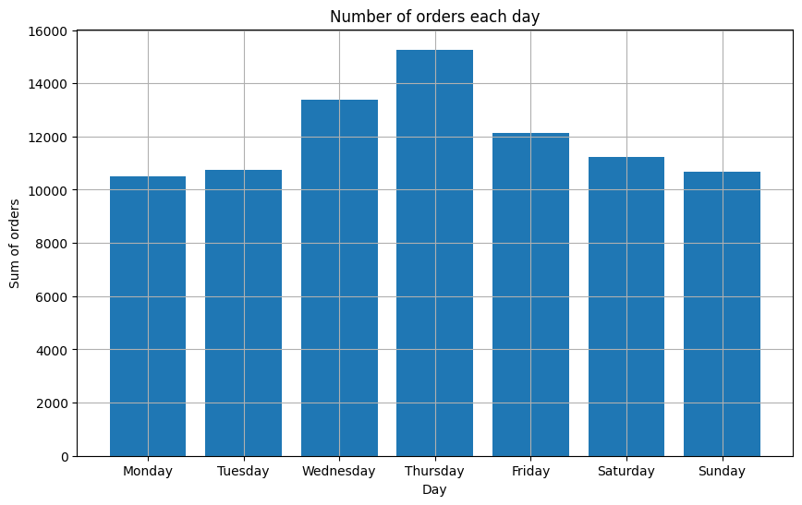
Which days of the month has the highest ride orders?
Notes:
Thursday has the highest with almost 16,000 orders which is followed closely by Wednesday and Friday. This can be attributed to the start of the festive season season as people are moving home

Slide 7
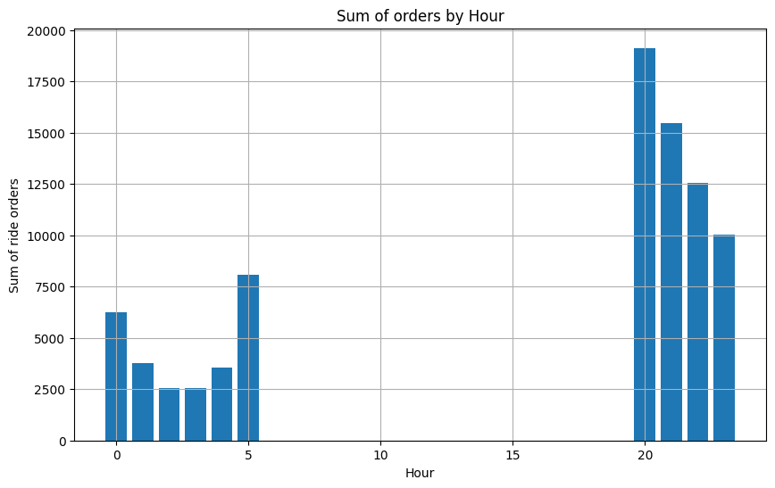
Which hours of the day have the highest ride orders?
Notes:
The gap just shows that customers are mostly working class
Peak orders are between 8pm to 11pm and this can be attributed to rush hour periods and midnight to 5am can be attributed to public transportation not being available.

Slide 8
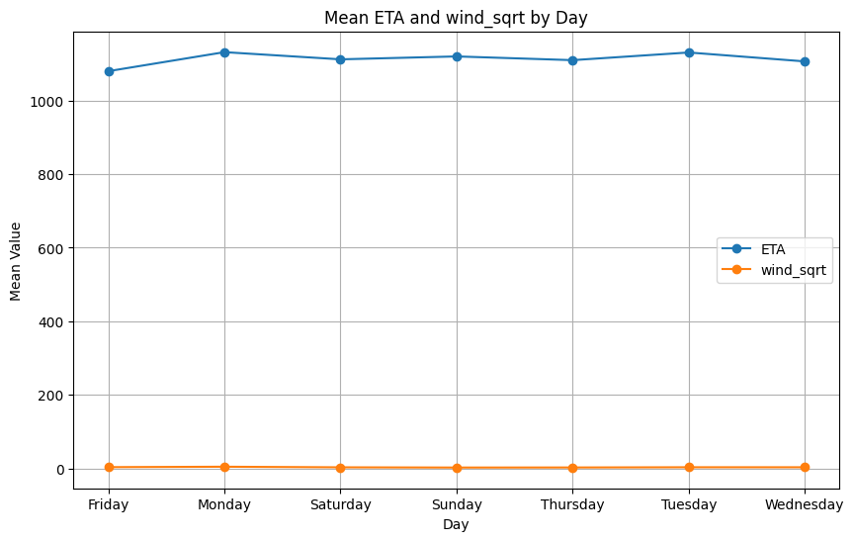
Does wind speed affect ETA?
Notes:
Can be clearly seen that wind has no effect of time of arrival

Slide 9
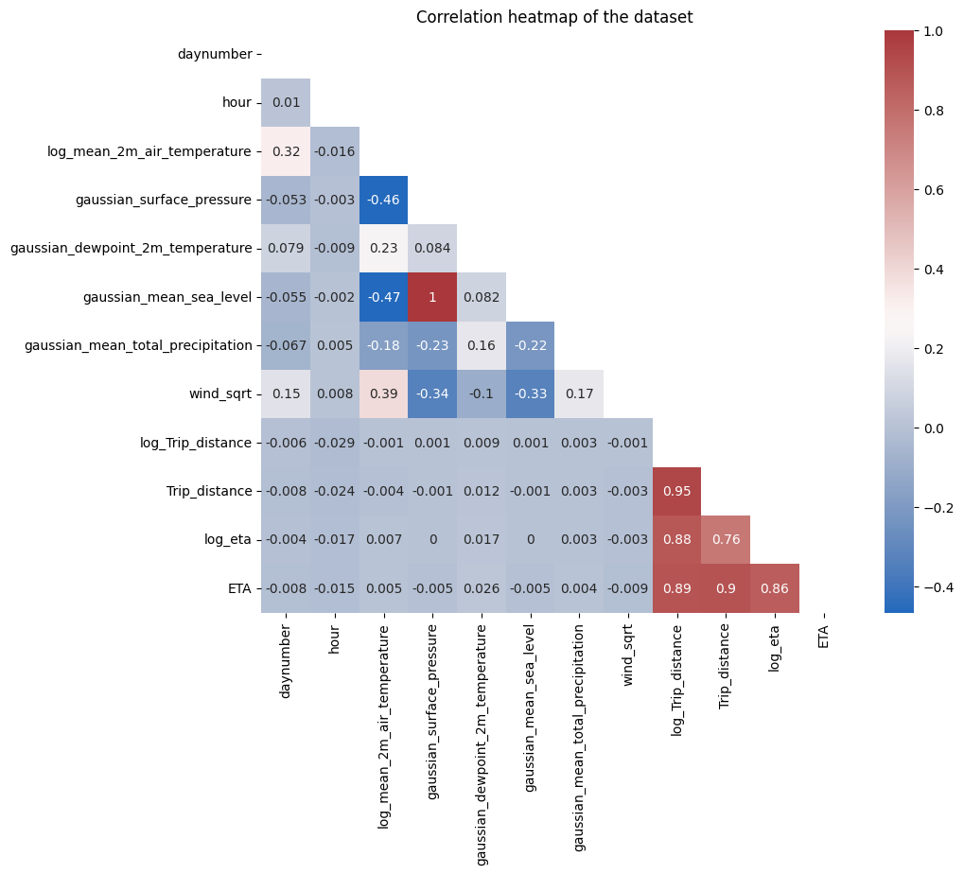
FEATURES of interest

Slide 10
FEATURES of interest
Mean_2m_air_temperature,Trip_distance,surface_pressure,mean_sea_level and dewpoint_2m_temperature were the features considered in building this model.
The log of these features was calculated and this gave a better correlation with ETA .
A gaussian filter applied to smoothen individual feature curves to improve prediction.

Slide 11
MODELs AND FEATURES
Models considered for the project are
Linear Regression
KN-Neighbours
Xgboost regressor
LGBM regressor
Support Vector Regression

Slide 12
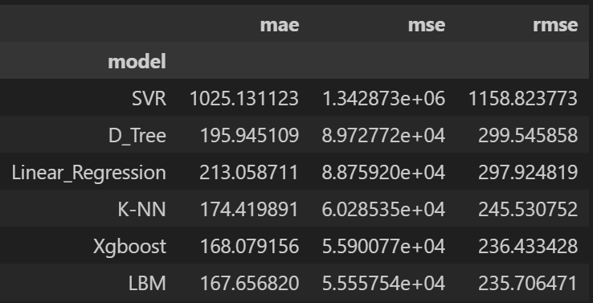
rsme

Slide 13
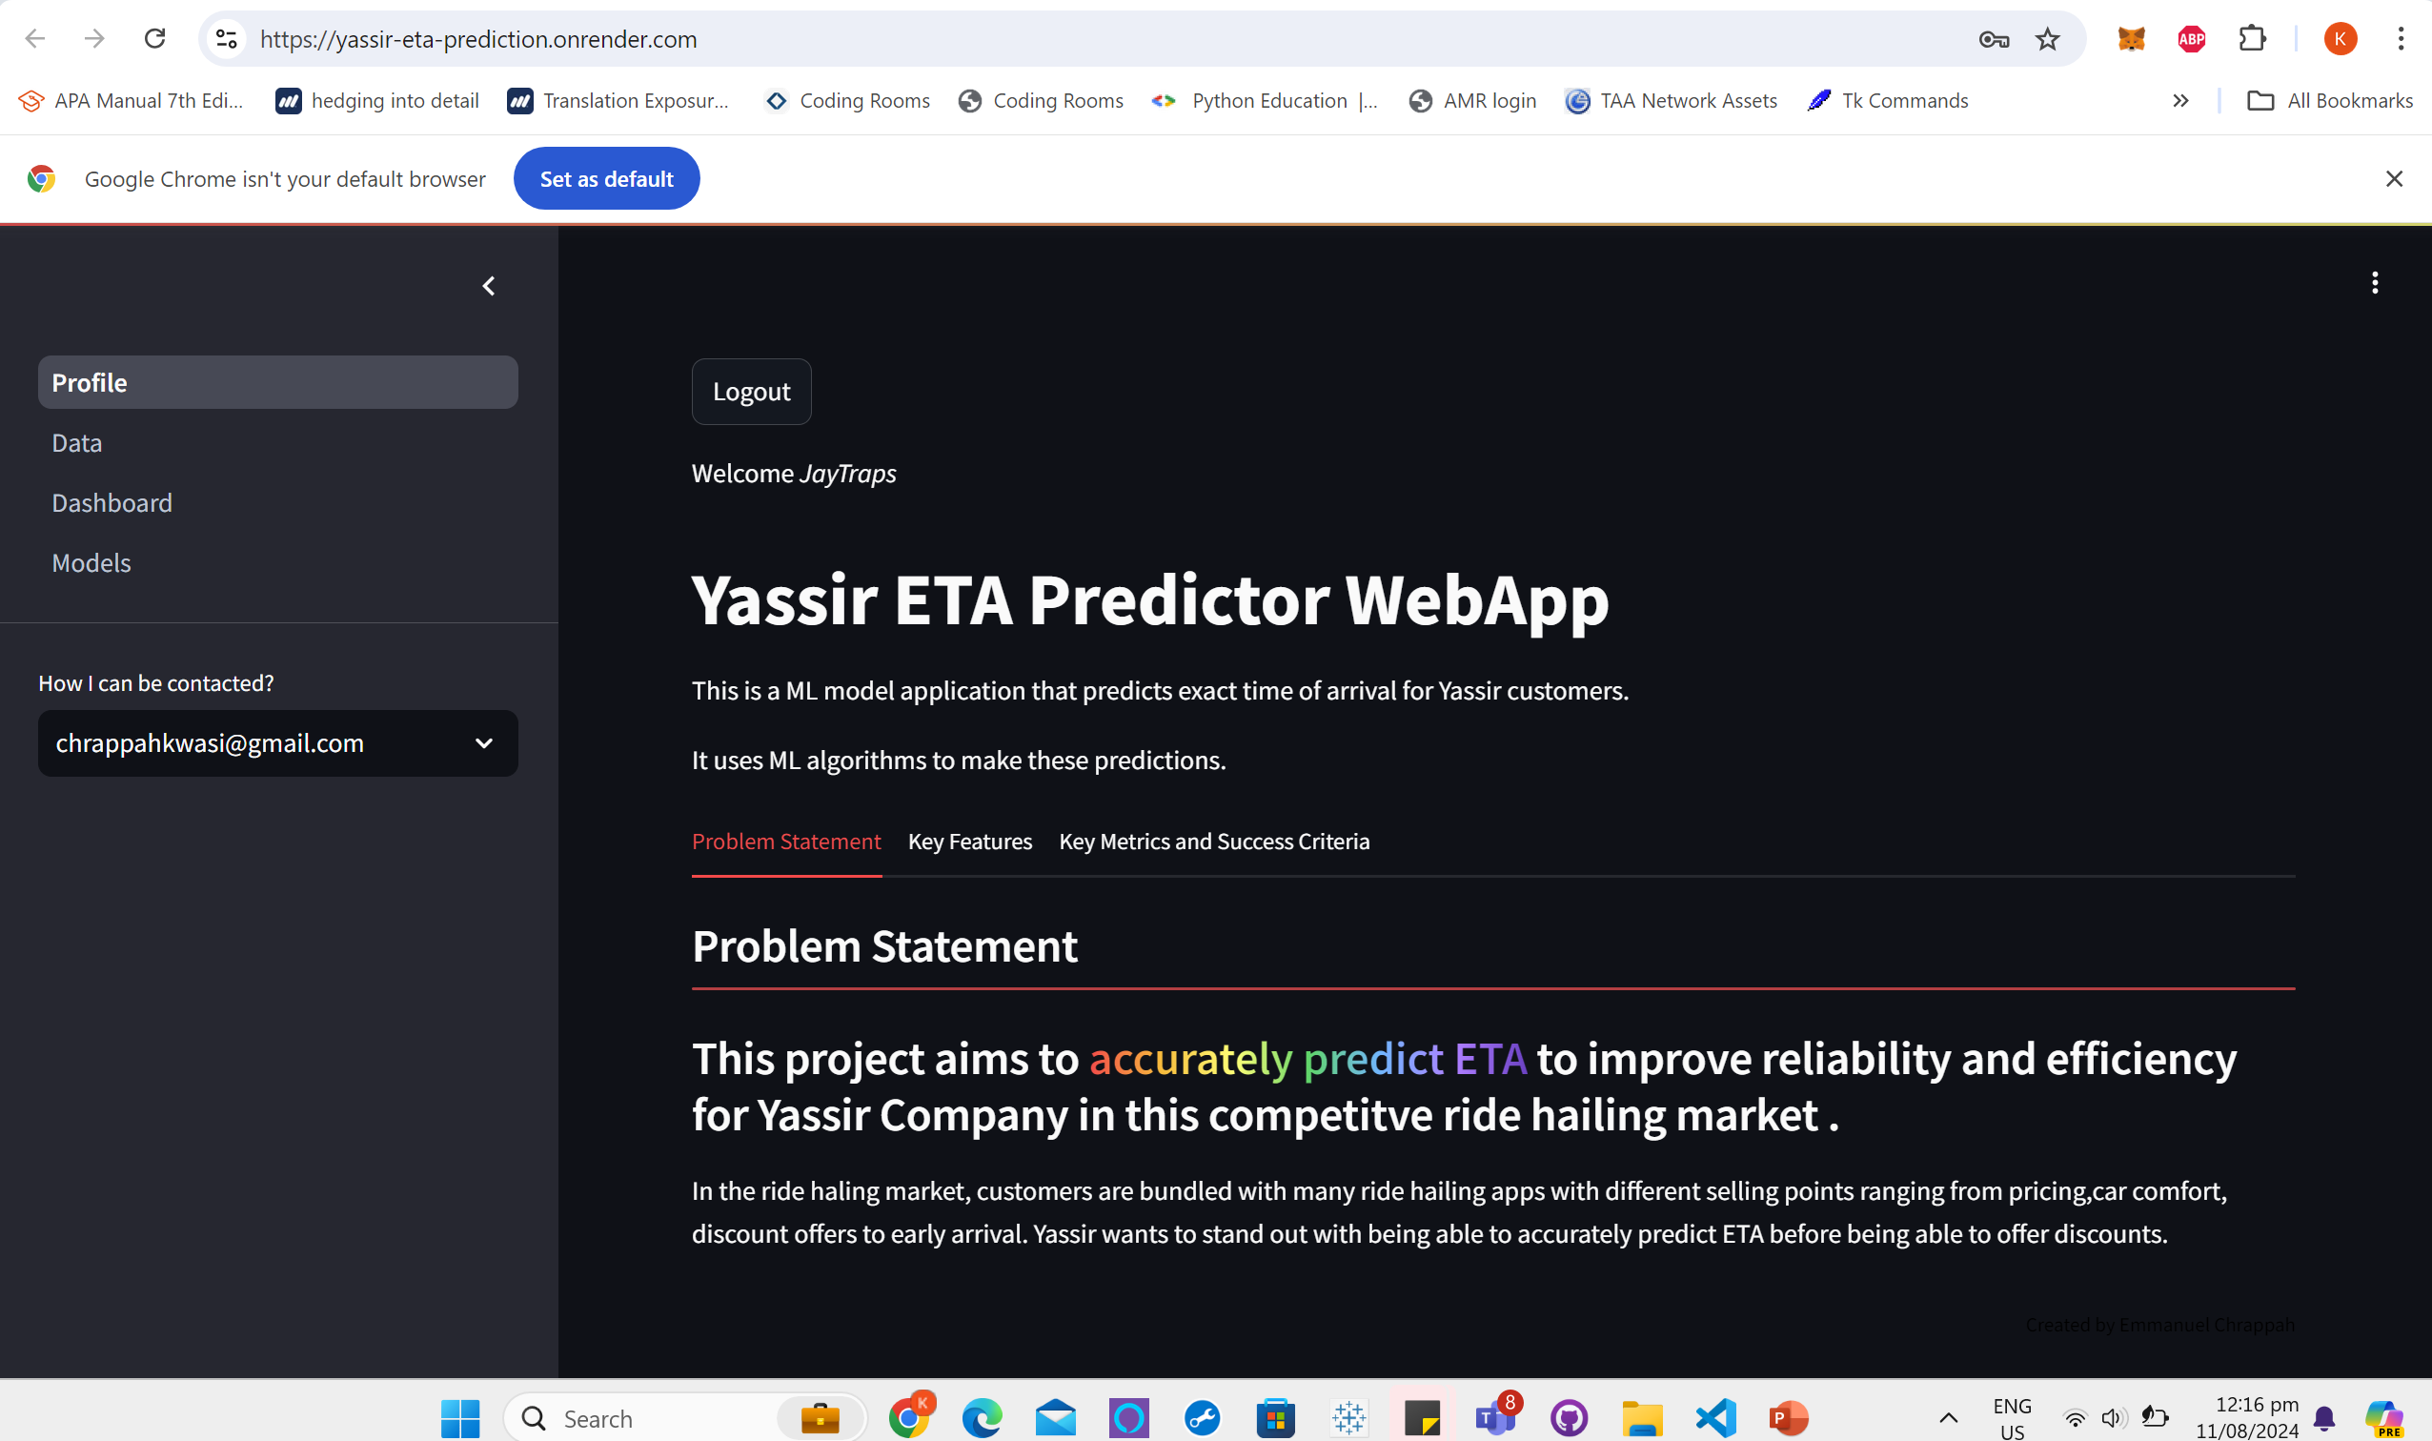
WebApp interface

Slide 14
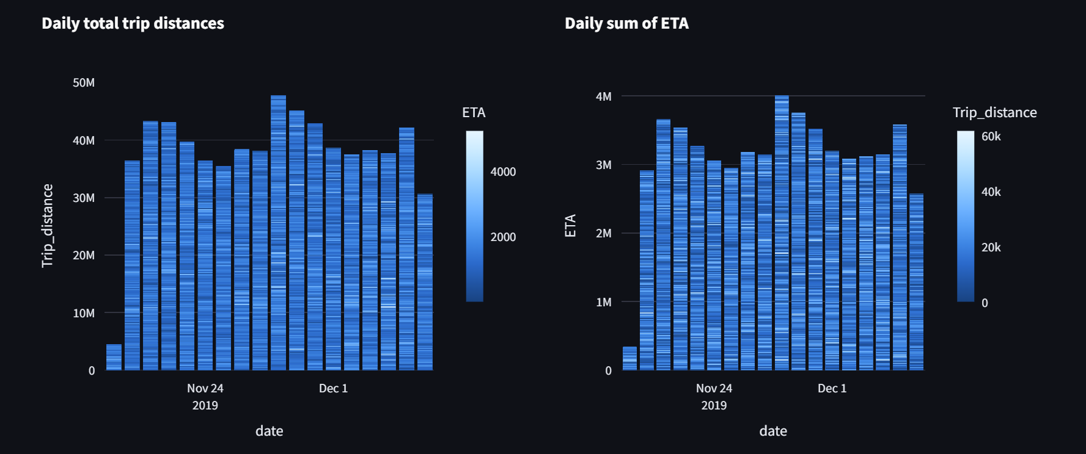
WebApp interface

Slide 15
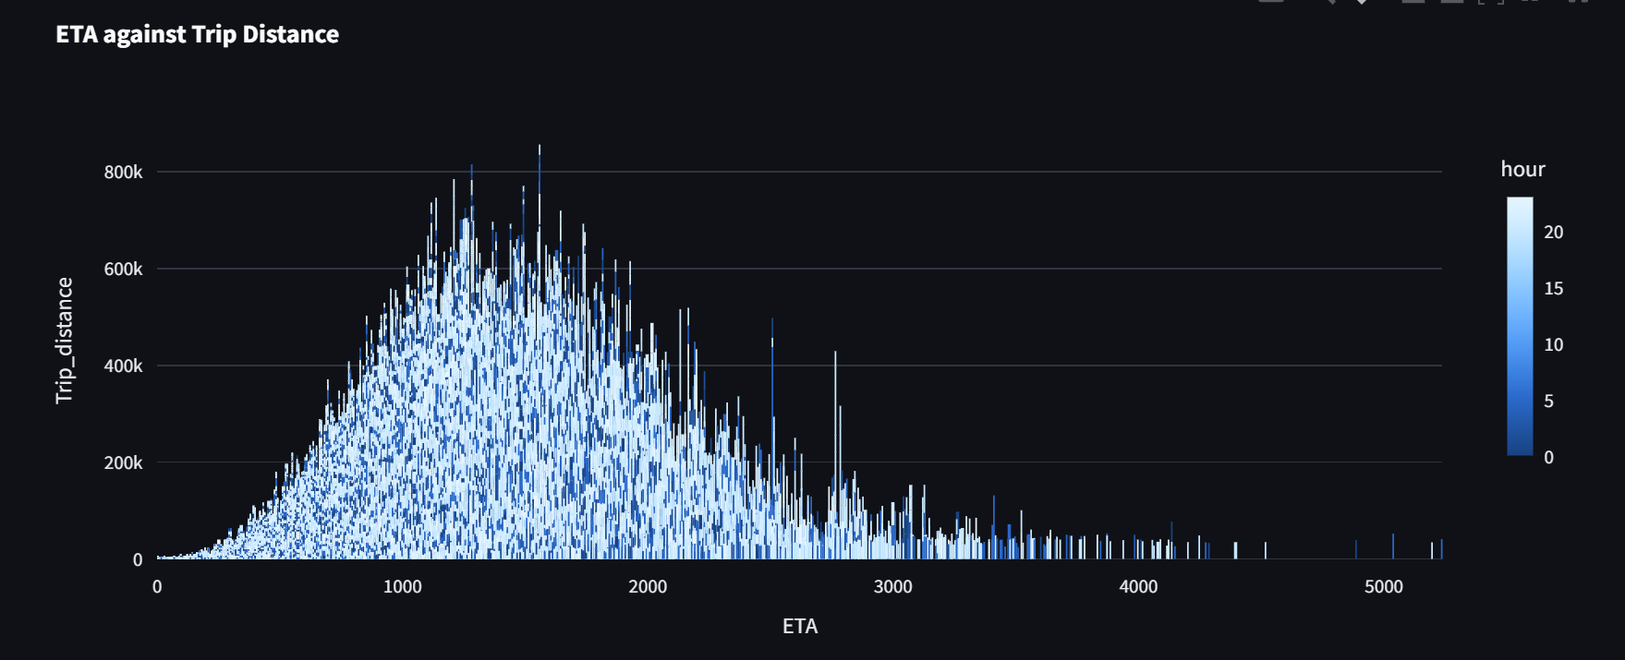
WebApp interface

Slide 16
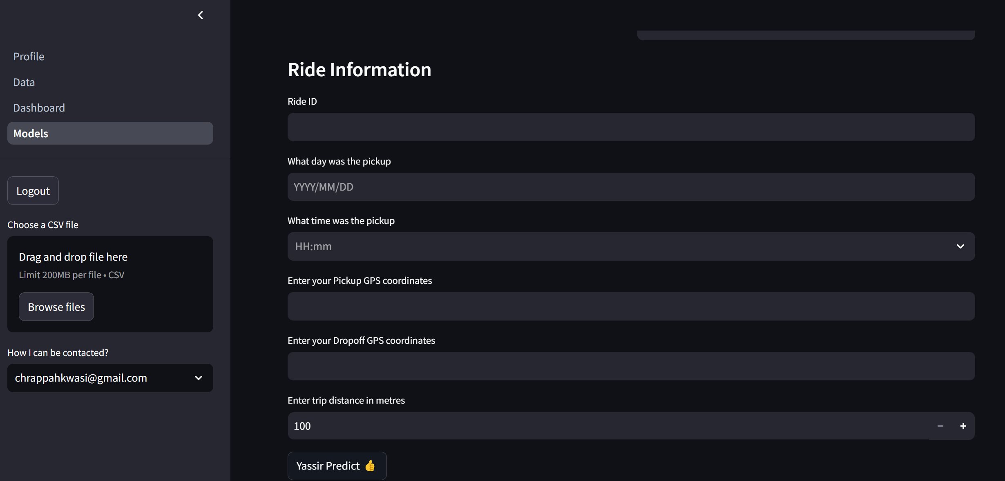
WebApp interface

Slide 17
THANK YOU

